Slide 1
NCI update – analyzing CyTOF data
12-6-2024
Ty Bottorff – Bioinformatics postdoc
Linsley lab

Slide 2
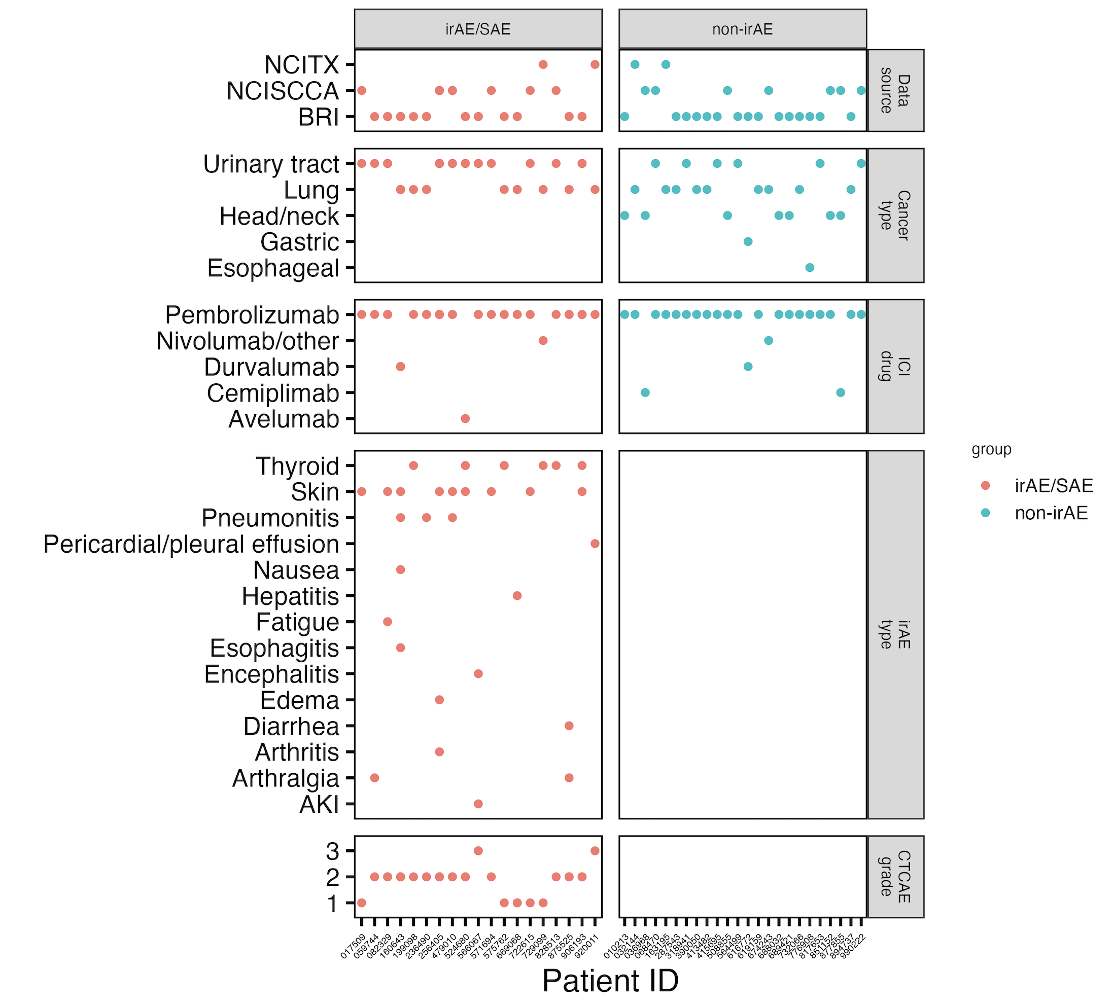
Cancer cohort metadata

Slide 3
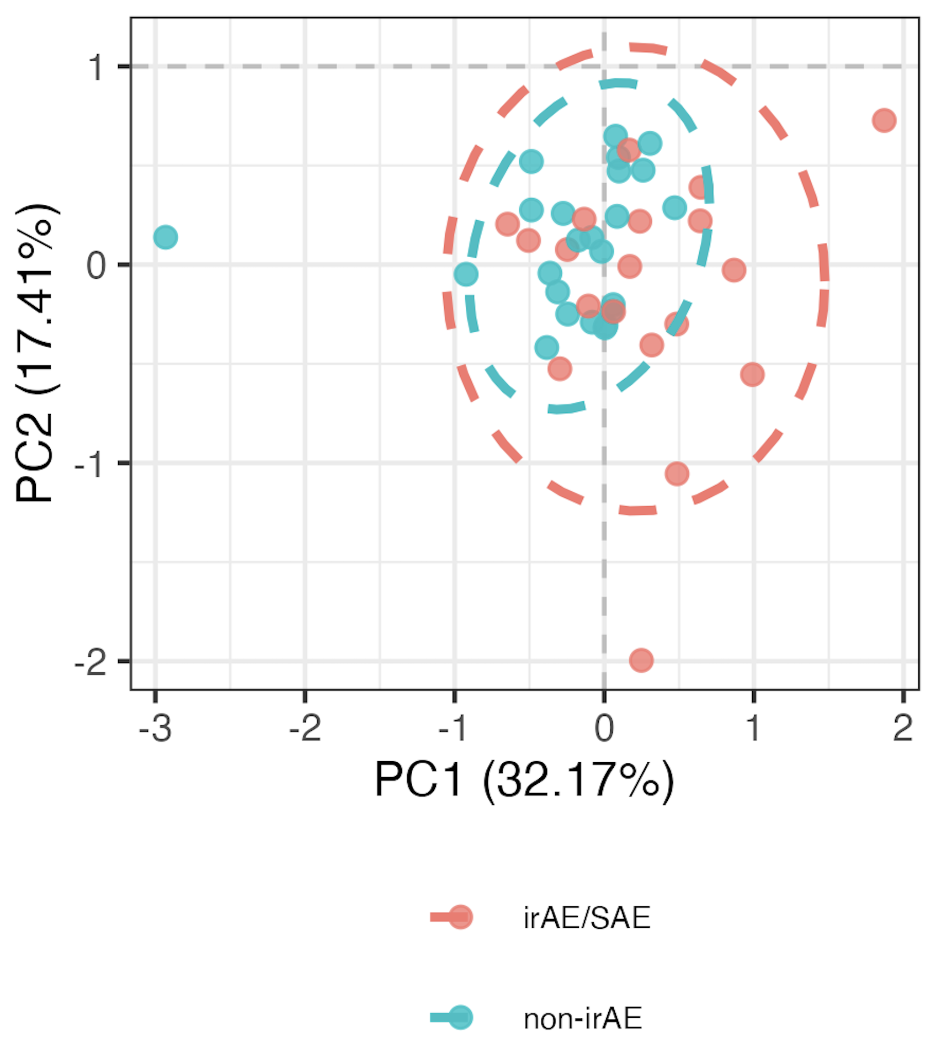
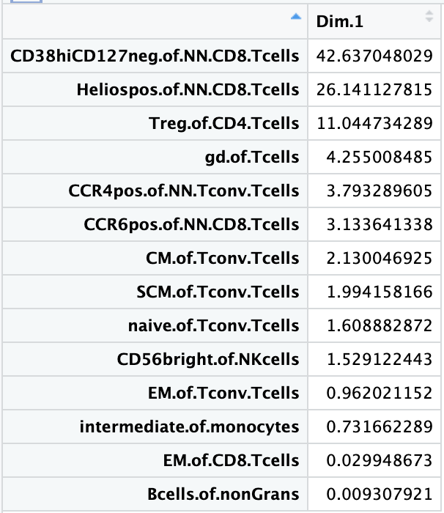
Using module of baseline feature frequencies, can differentiate between those who develop irAEs
PC1 pval: 0.013
PC1 contributions

Slide 4
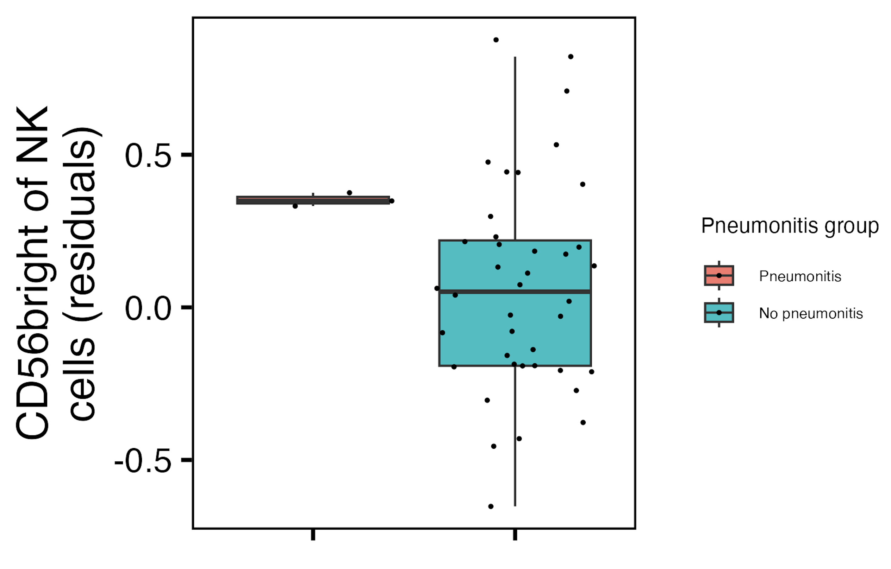
Baseline CD56^{bright} of NK cells frequency higher in those developing pneumonitis
padj = 3.4*10⁻⁴
Notes:
~similar if including pleural effusion (pval drops to 2.7 from 3.4)

Slide 5
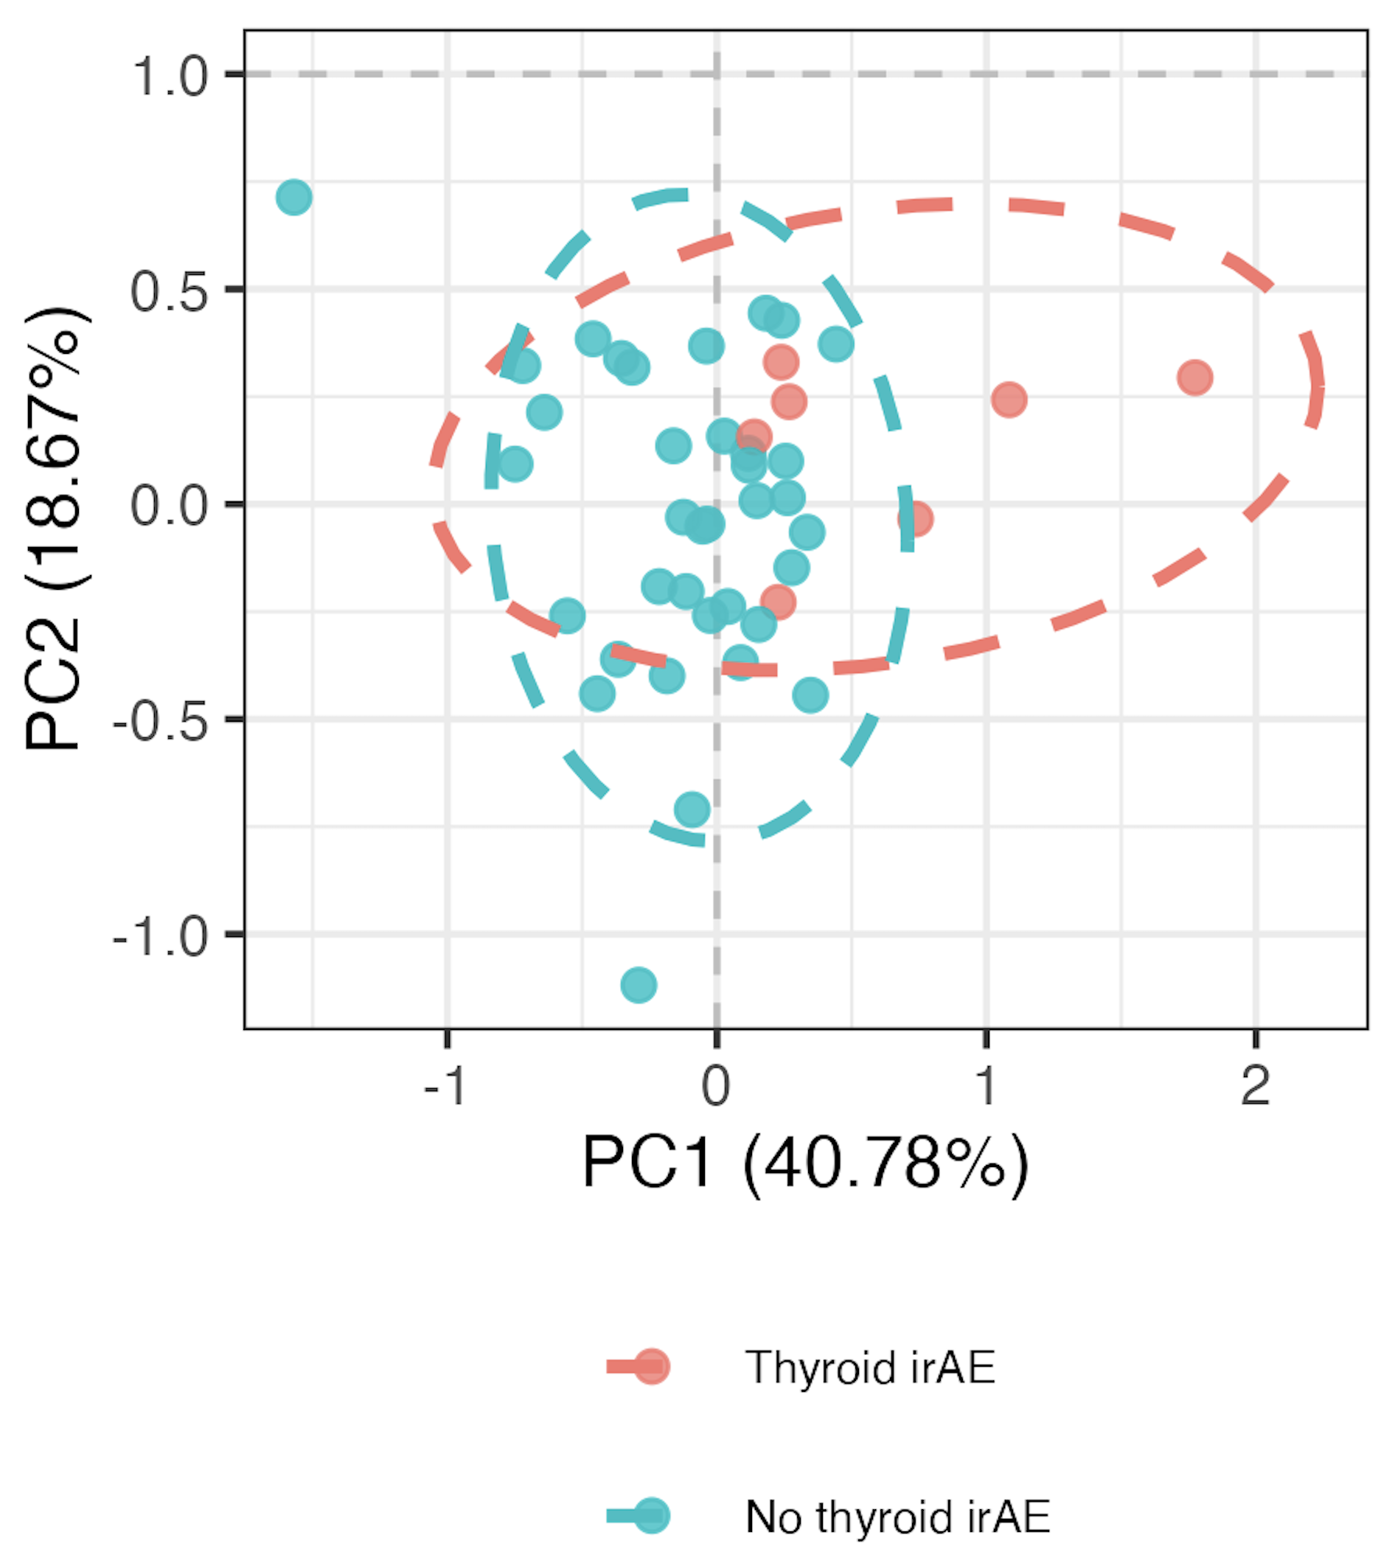
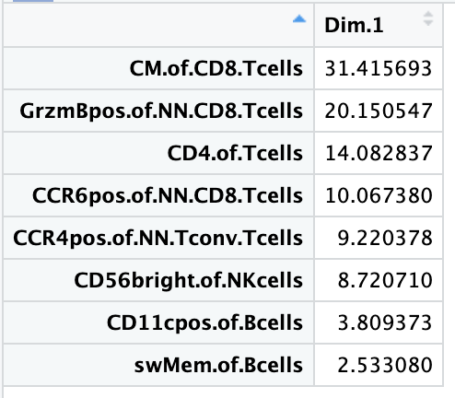
Using module of baseline feature frequencies, can differentiate between those who develop thyroid irAEs
PC1 contributions
PC1 pval: 0.015
Notes:
~similar if including OOR in sense that module needed and then see PC1 (and then PC3) significantly different, contributing features ~different

Slide 6
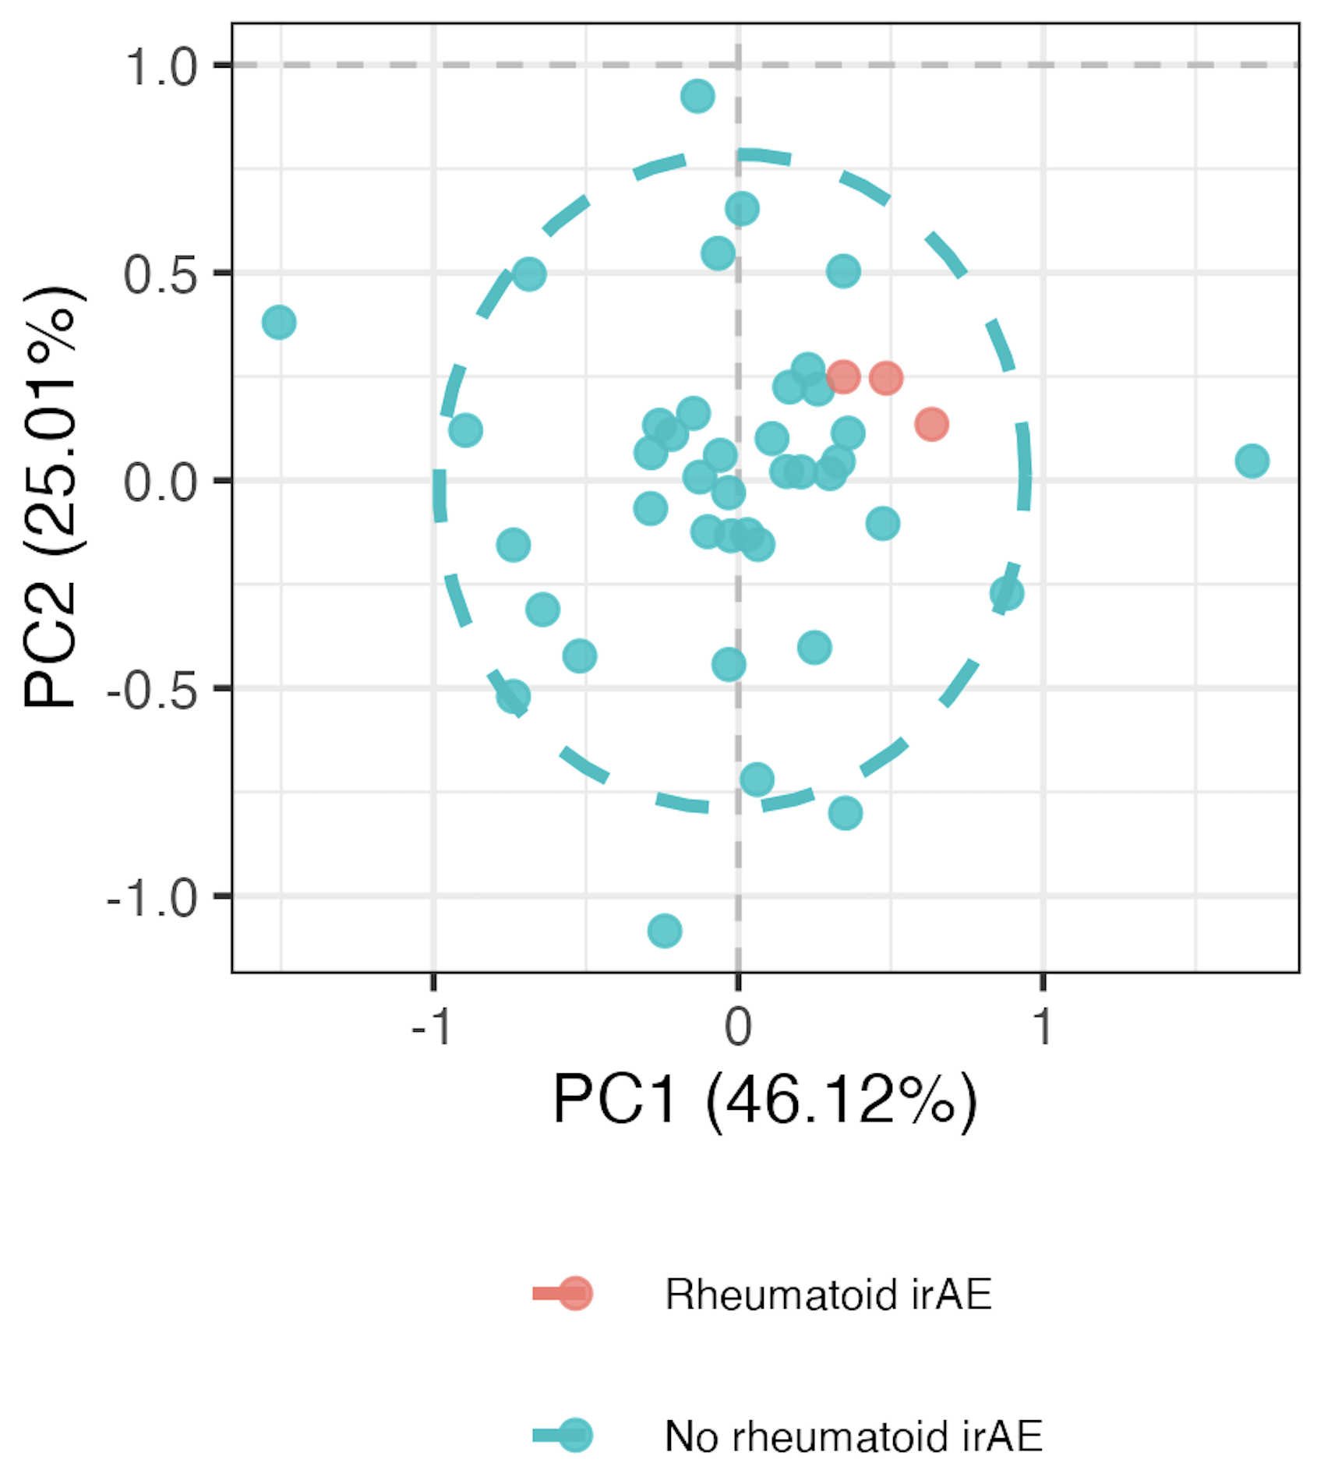
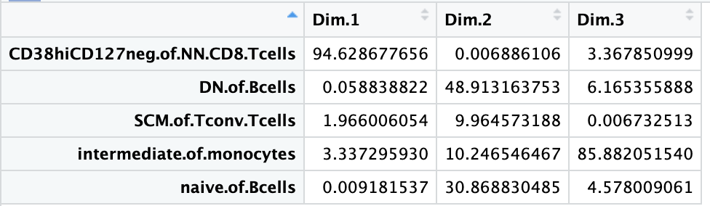
Using module of baseline feature frequencies, can differentiate between those who develop “rheumatoid” irAEs
PC1 pval: 0.003
PC2 pval: 0.005
PC3 pval: 0.027

Slide 7
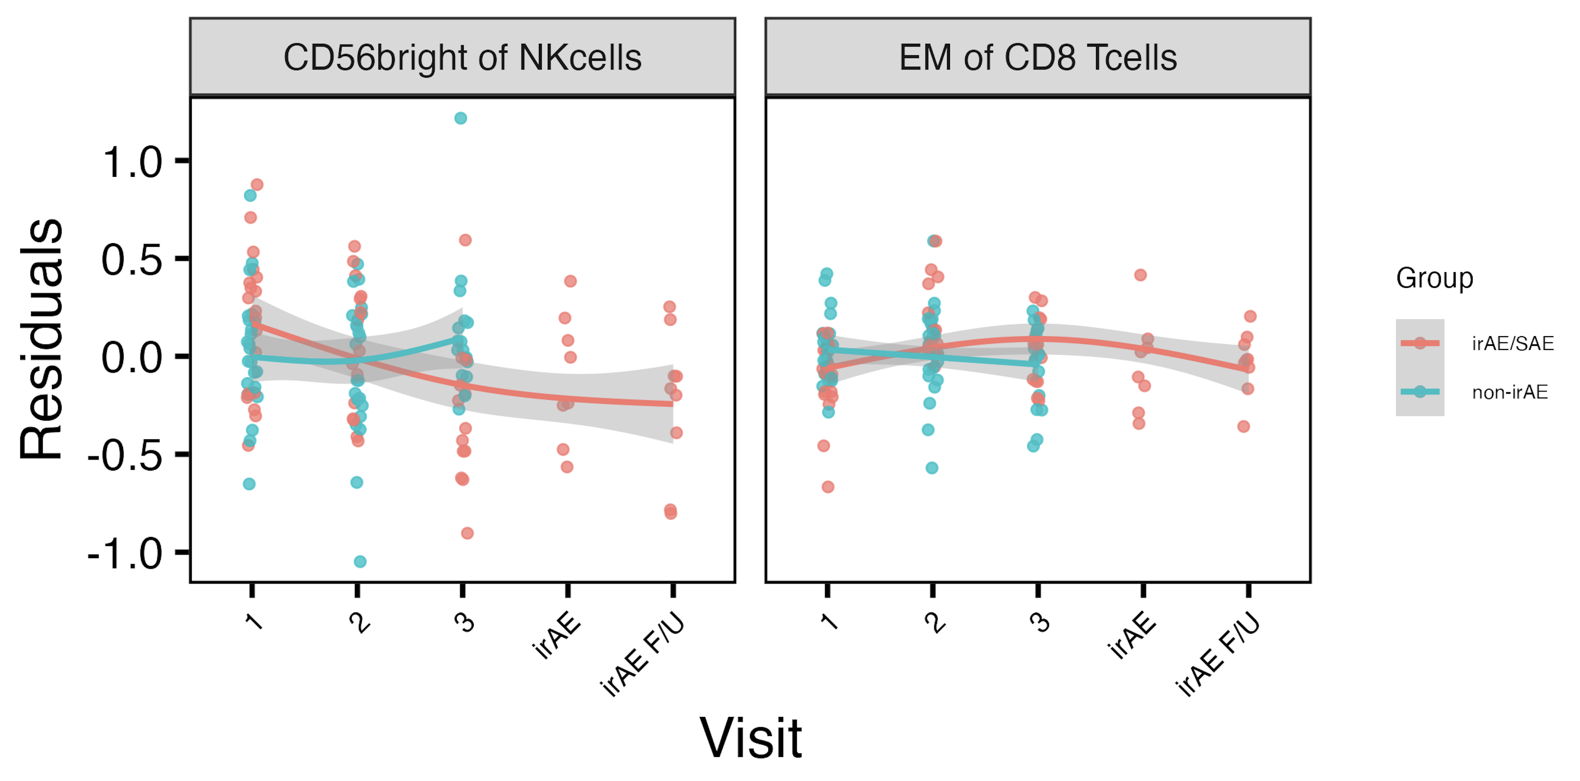
Longitudinal analyses: treatment-combined irAE group effects
*
*
Used mixed effect non-linear model w/ interaction b/w irAE group & visit, random effect for donor, visits 1-3
*: padj < 0.05
Notes:
GAM modeling
padj < 0.05
# CD56: visit3-group interaction (also see this for skin irAE instesd of combined)
# EM of CD8s: 2-group interaction

Slide 8
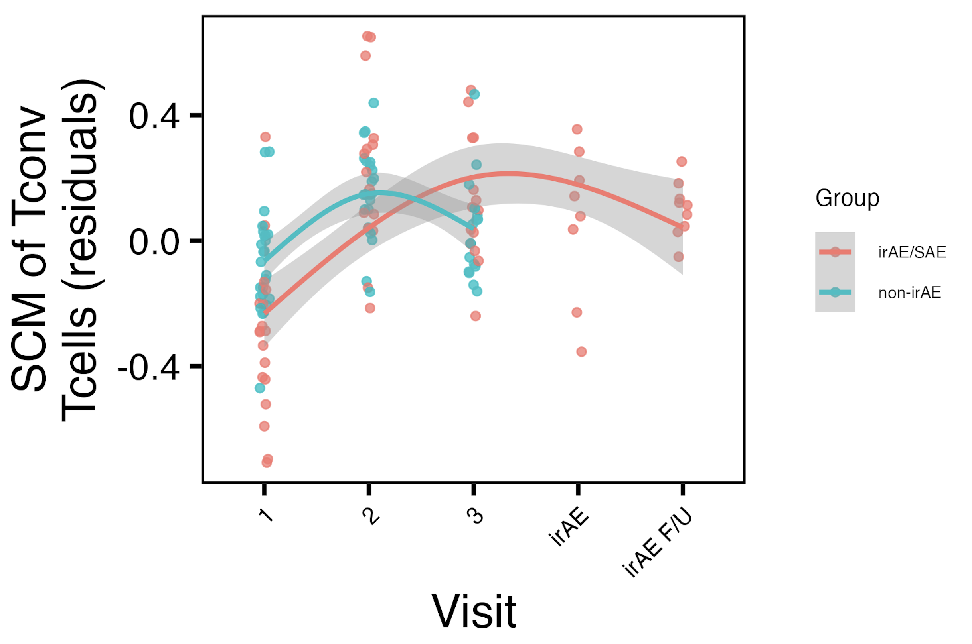
SCM of T_{conv} T_{cells}: weak baseline effect propagates to visit 2, treatment-combined irAE group effect at visit 3
*
*
*: padj < 0.05
Notes:
padj = 0.065 for baseline group comparison
# SCM of Tconv: group, visit2, visits2/3+group interaction results padj < 0.05

Slide 9
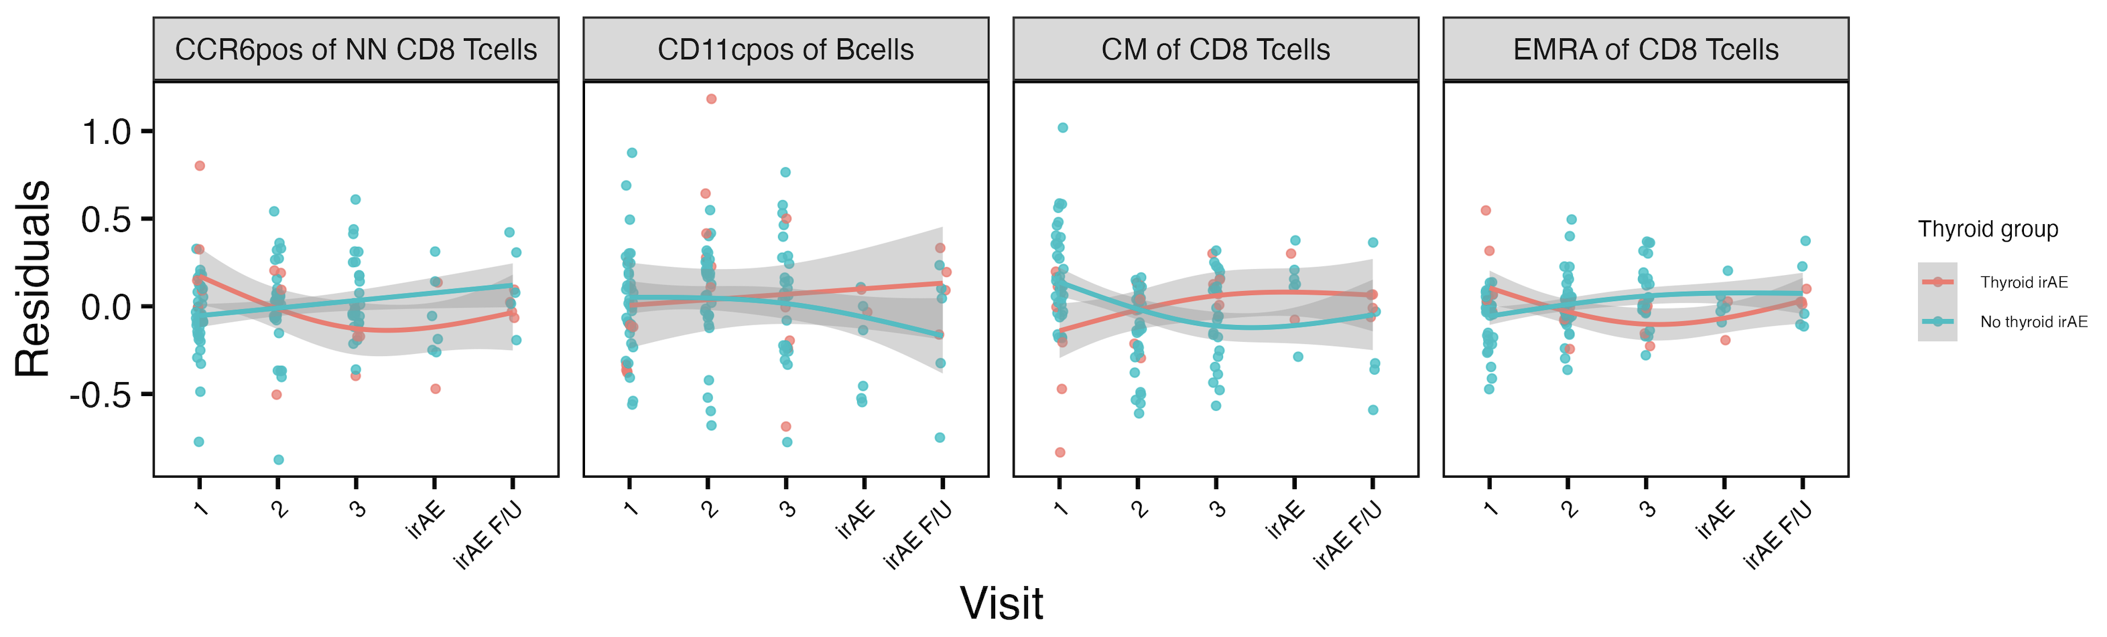
Longitudinal analyses: treatment-thyroid irAE group effects
*
*
*
*
*: padj < 0.05

Slide 10
Conclusions
Baseline analyses
can use module of features to identify immunotypes of combined irAE, thyroid irAEs, “rheumatoid” irAEs at baseline
CD56^{bright} of NK cells frequencies different between pneumonitis groups at baseline
baseline immunotypes of those developing and not developing skin irAEs are similar (even with top feature module approach)
Longitudinal analyses: some feature frequencies change with treatment in group-specific manner
combined irAEs: CD56^{bright} of NK cells, EM of CD8s
thyroid irAEs: CCR6⁺ of NN CD8s, CD11c⁺ of Bcells, CM of CD8s, EMRA of CD8s

Slide 11
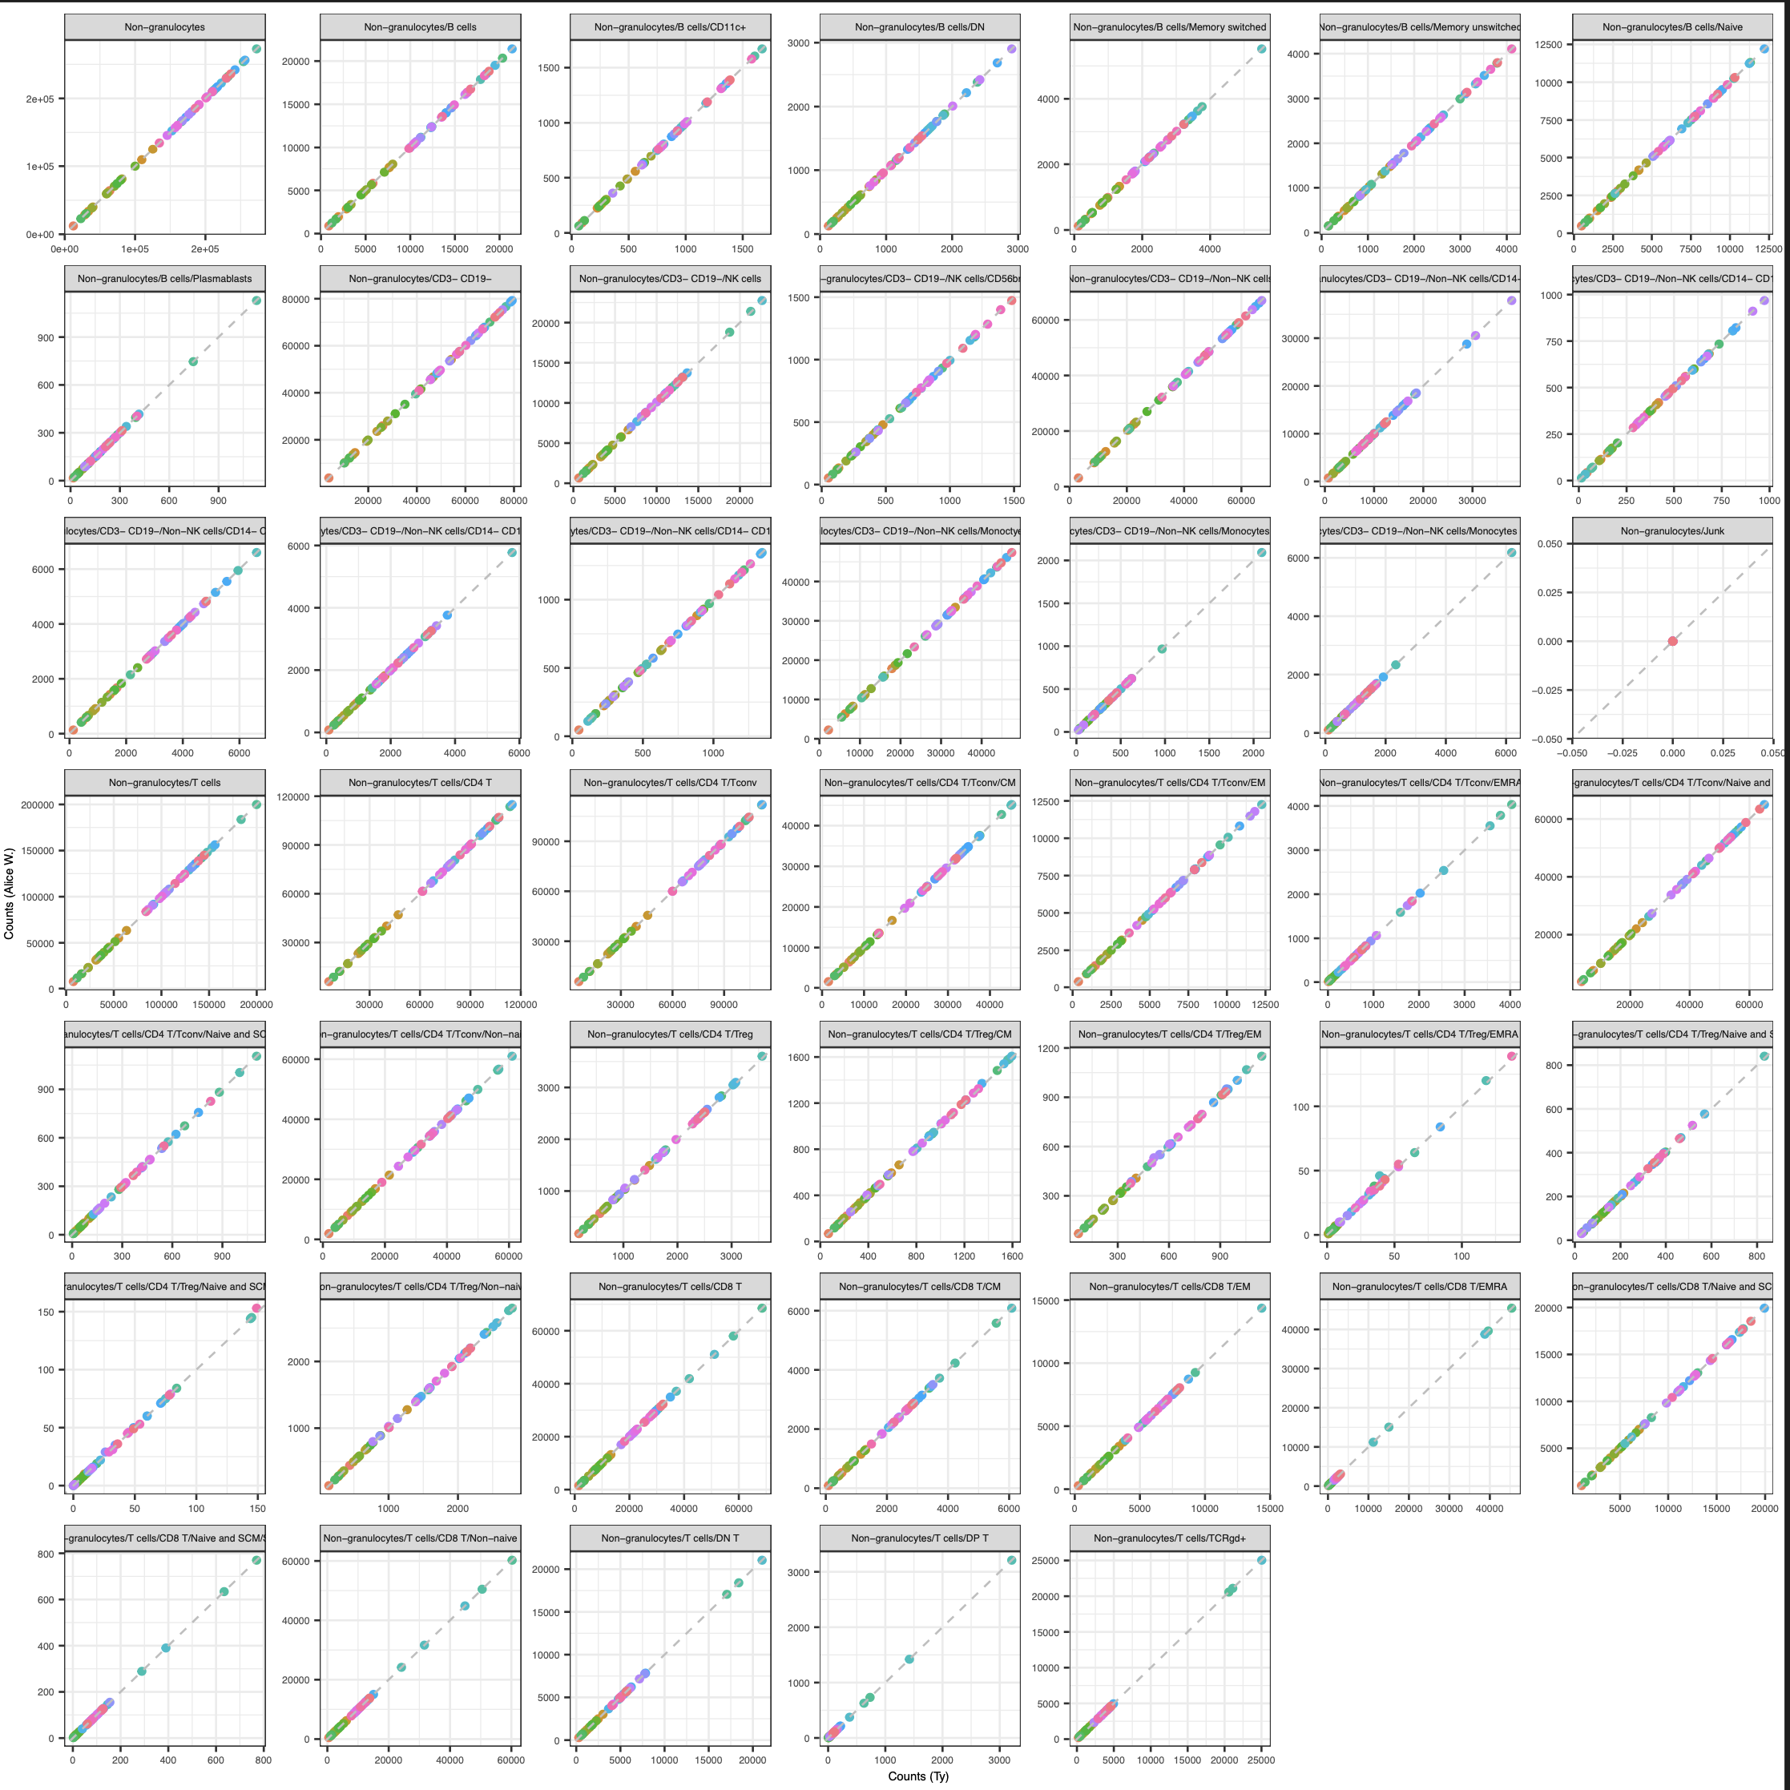
Next steps
IMPACD
created gating set in R, counts are ~expected values
will next apply IMPACD gates to investigate more granular subsets’ group differences at baseline

Slide 12

Acknowledgements
Holly Akilesh
Long lab/HIPcore
Alice Long, Alice Wiedeman
Buckner lab
Jane Buckner, Sylvia Posso
Peter Linsley
Clinical team

Slide 13
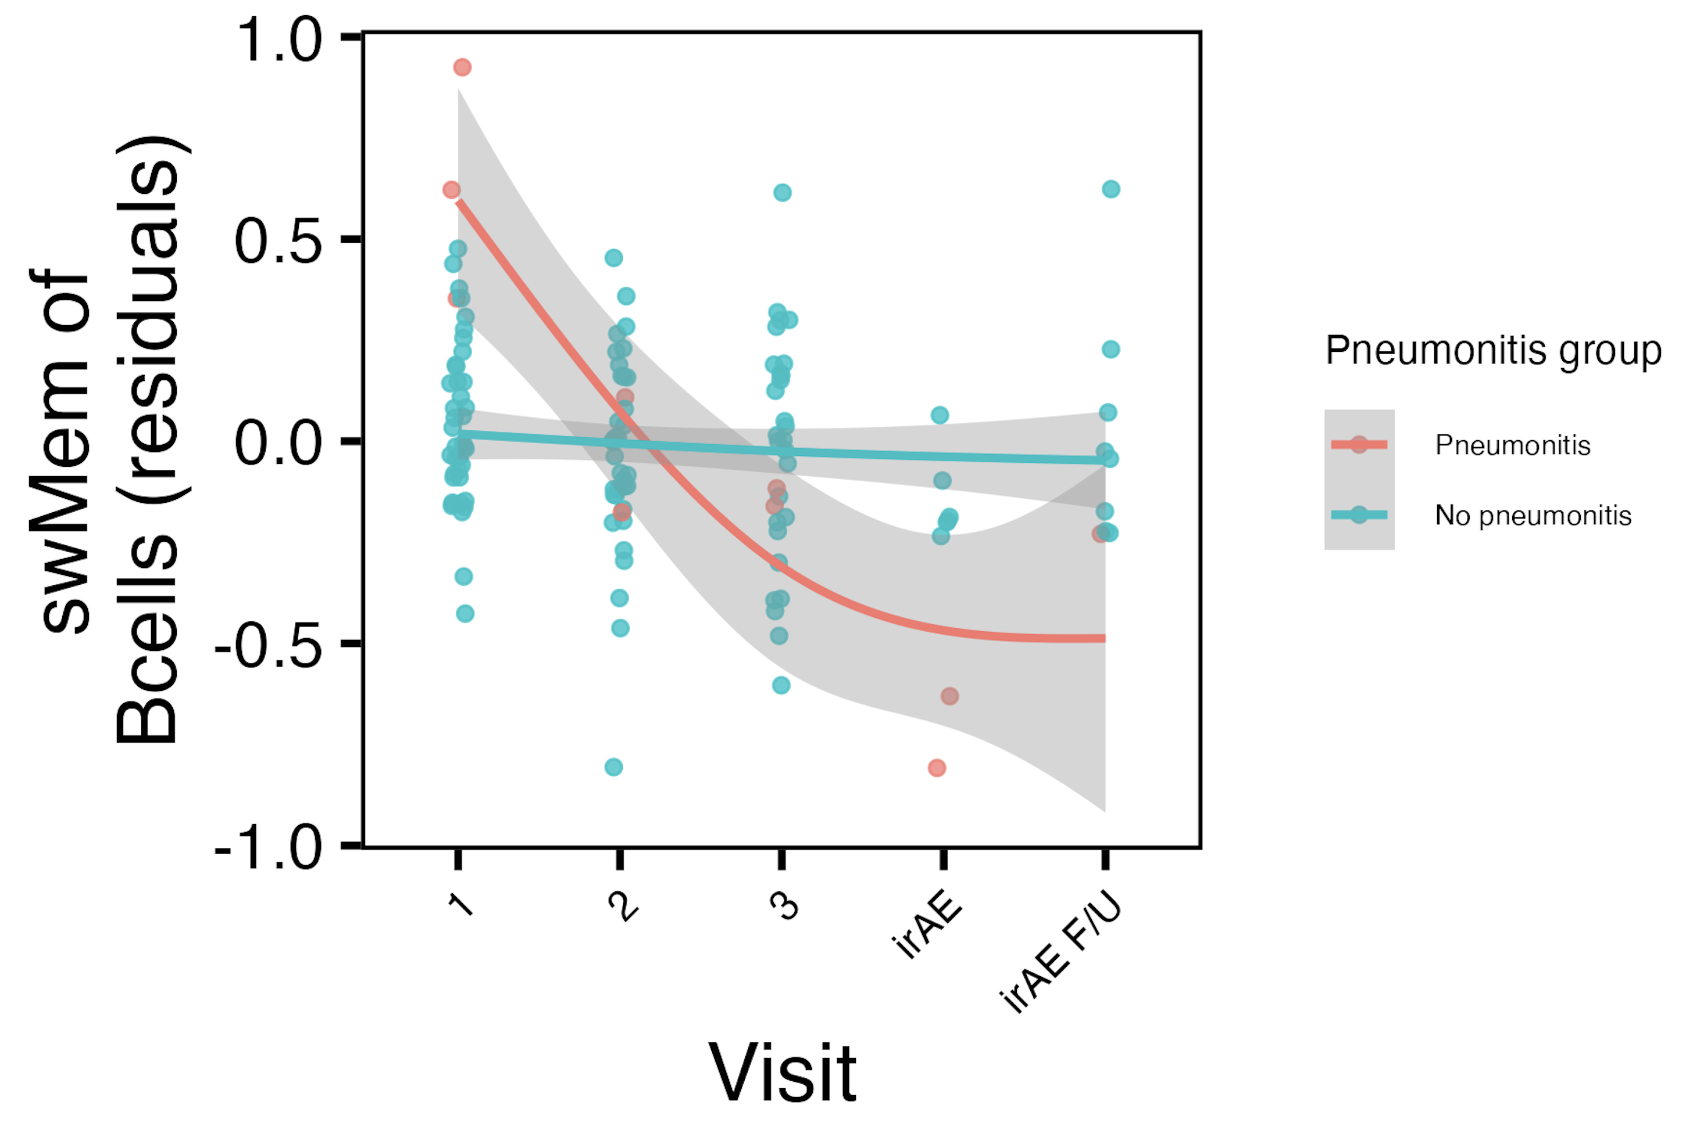
Longitudinal analyses: pneumonitis irAE group effect
Notes:
padj < 0.05

Slide 14
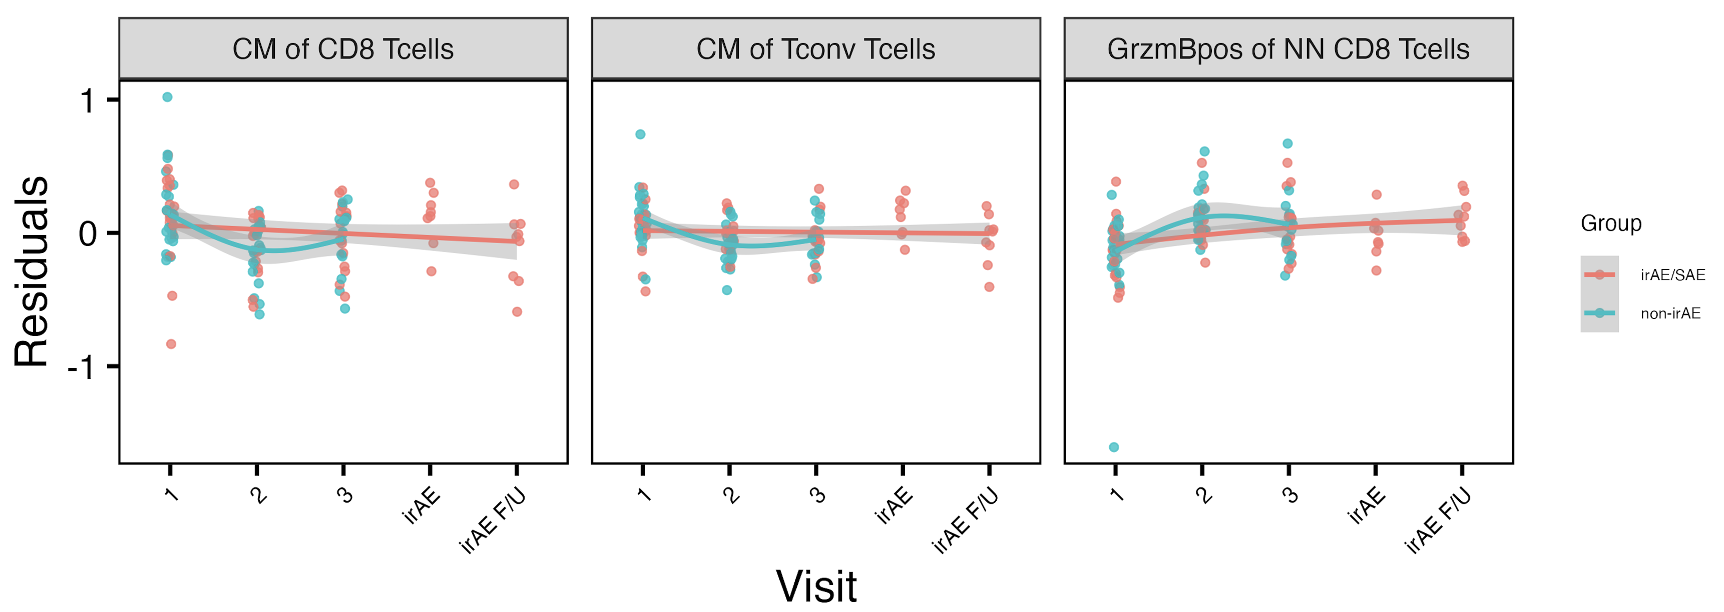
Longitudinal analyses: treatment effects across combined irAE groups
*
**
*
Notes:
padj < 0.05
# CM of CD8s: visit2
# CM of Tconv: visit 2, ** (padj < 0.01)
# GzmB: visit2

